Slide 1





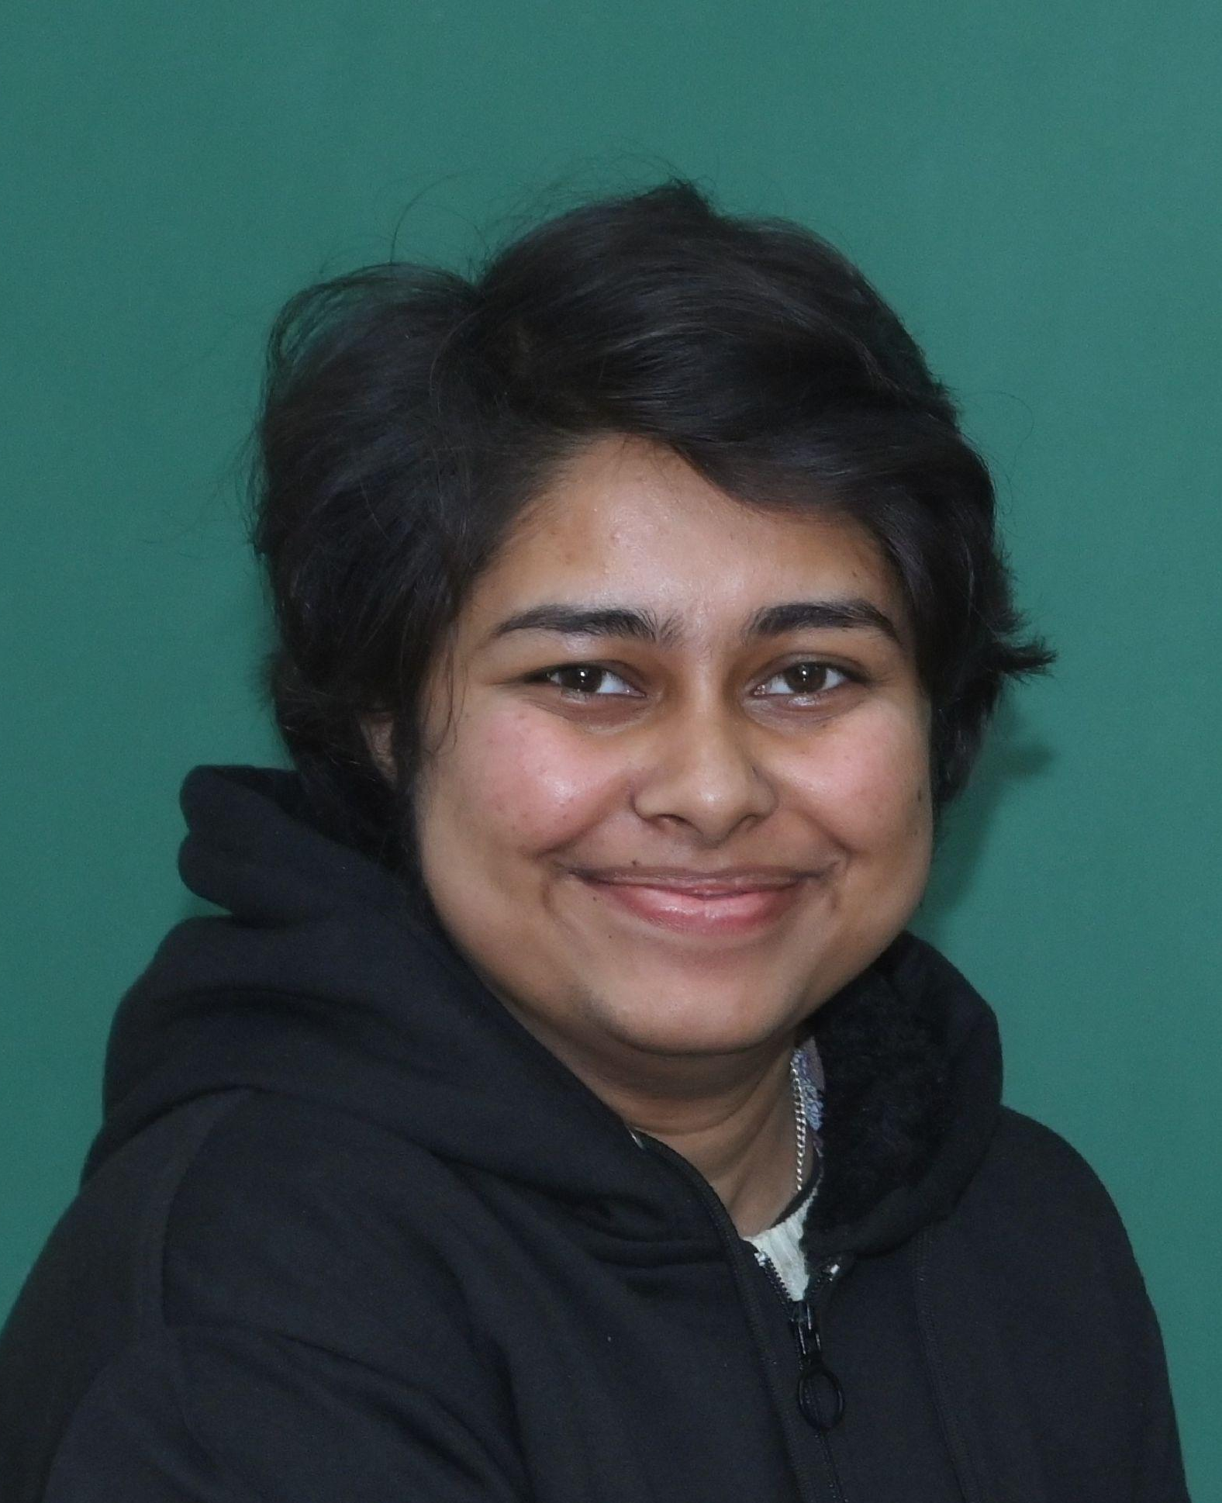
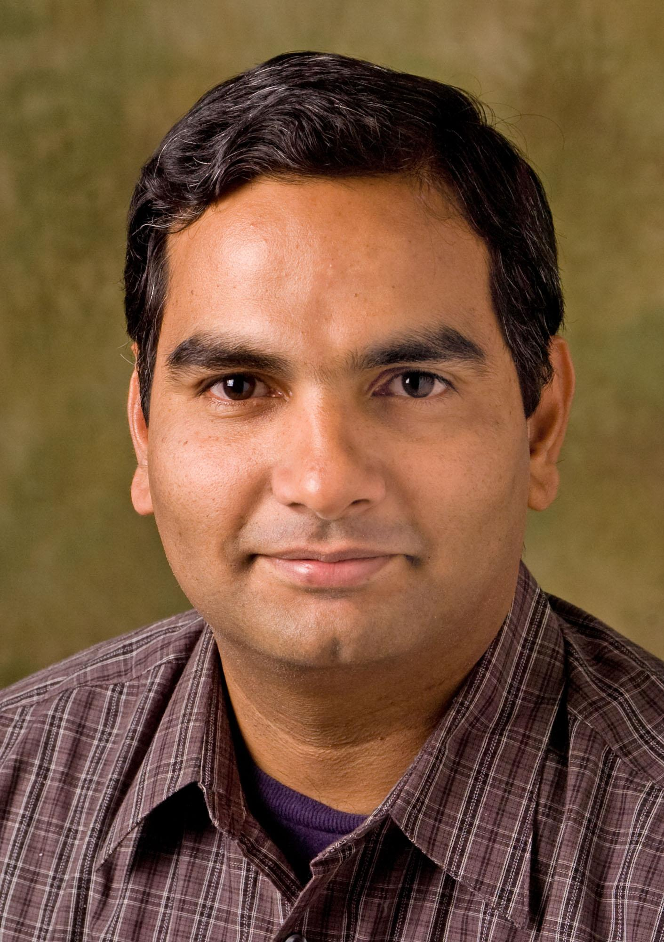
Python for Data Science
25.01.25 - 15.02.25
NPTEL
Instructor: Prof. Ragunathan Rengasamy(IIT Madras)
TA : Nilakshi Senapati (IIT Kanpur)
Problem Solving and Doubt Clearing :
Every Saturday 5:00 pm to 7:00 pm

Slide 2
Python for Data Science
Tutorial 1 - 25.01.25
NPTEL
Instructor: Prof. Ragunathan Rengasamy(IIT Madras)
TA : Nilakshi Senapati (IIT Kanpur)
Problem Solving and Doubt Clearing :
Every Saturday 5:00 pm to 7:00 pm

Slide 3
Python for Data Science
Introduction
NPTEL
Week 1 :
Details of the course : Elective
Category : Computer Science & Engineering/ Artificial Intelligence/ Data Science
Books :
1. Introduction to linear algebra - by Gilbert Strang
2. Applied statistics and probability for engineers – by Douglas Montgomery
3. Mastering python for data science, Samir Madhavan
Google meet link for classes : https://meet.google.com/uyx-dhev-rys

Slide 4
Python for Data Science
Introduction
NPTEL
Week 1 :
Date of Exam : 22nd March 2025
Exam : Morning Session - 9am to 12 noon ; Afternoon Session - 2 pm to 5 pm
Registration deadline : 14th March , 5:00 pm (Friday)

Slide 5
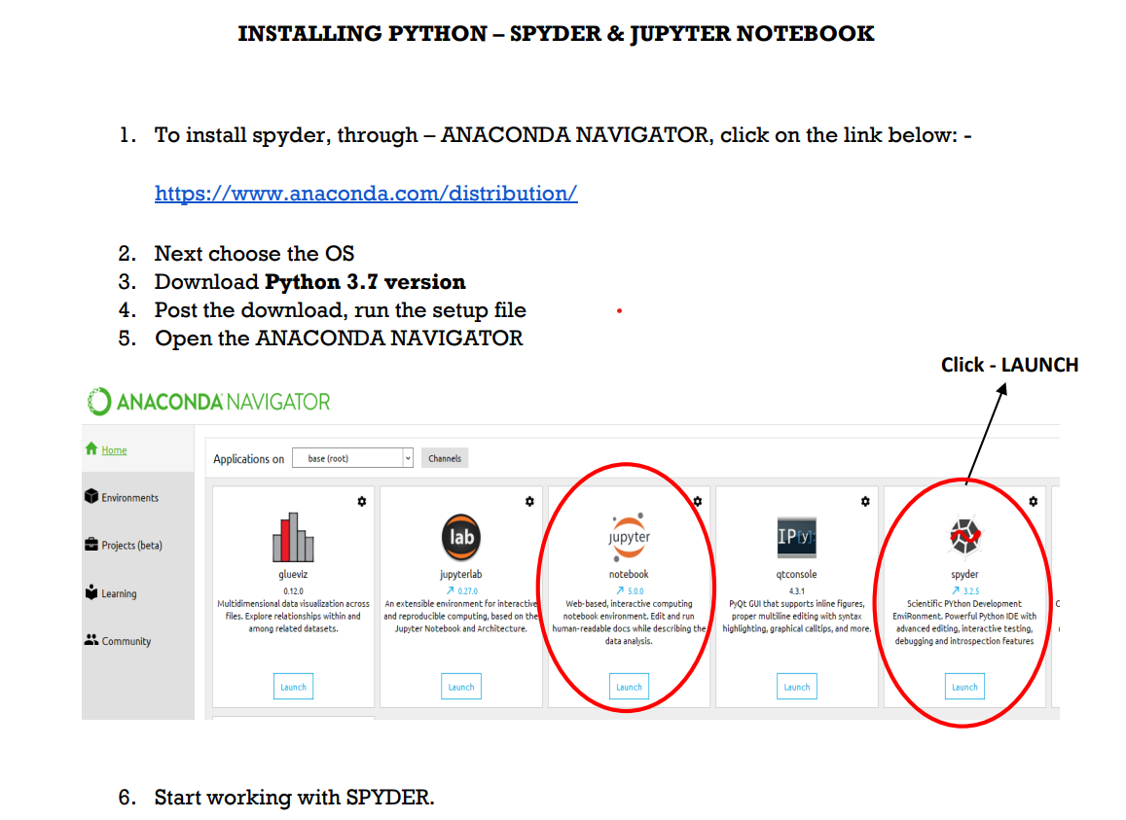
Python for Data Science
Introduction
NPTEL

Slide 6
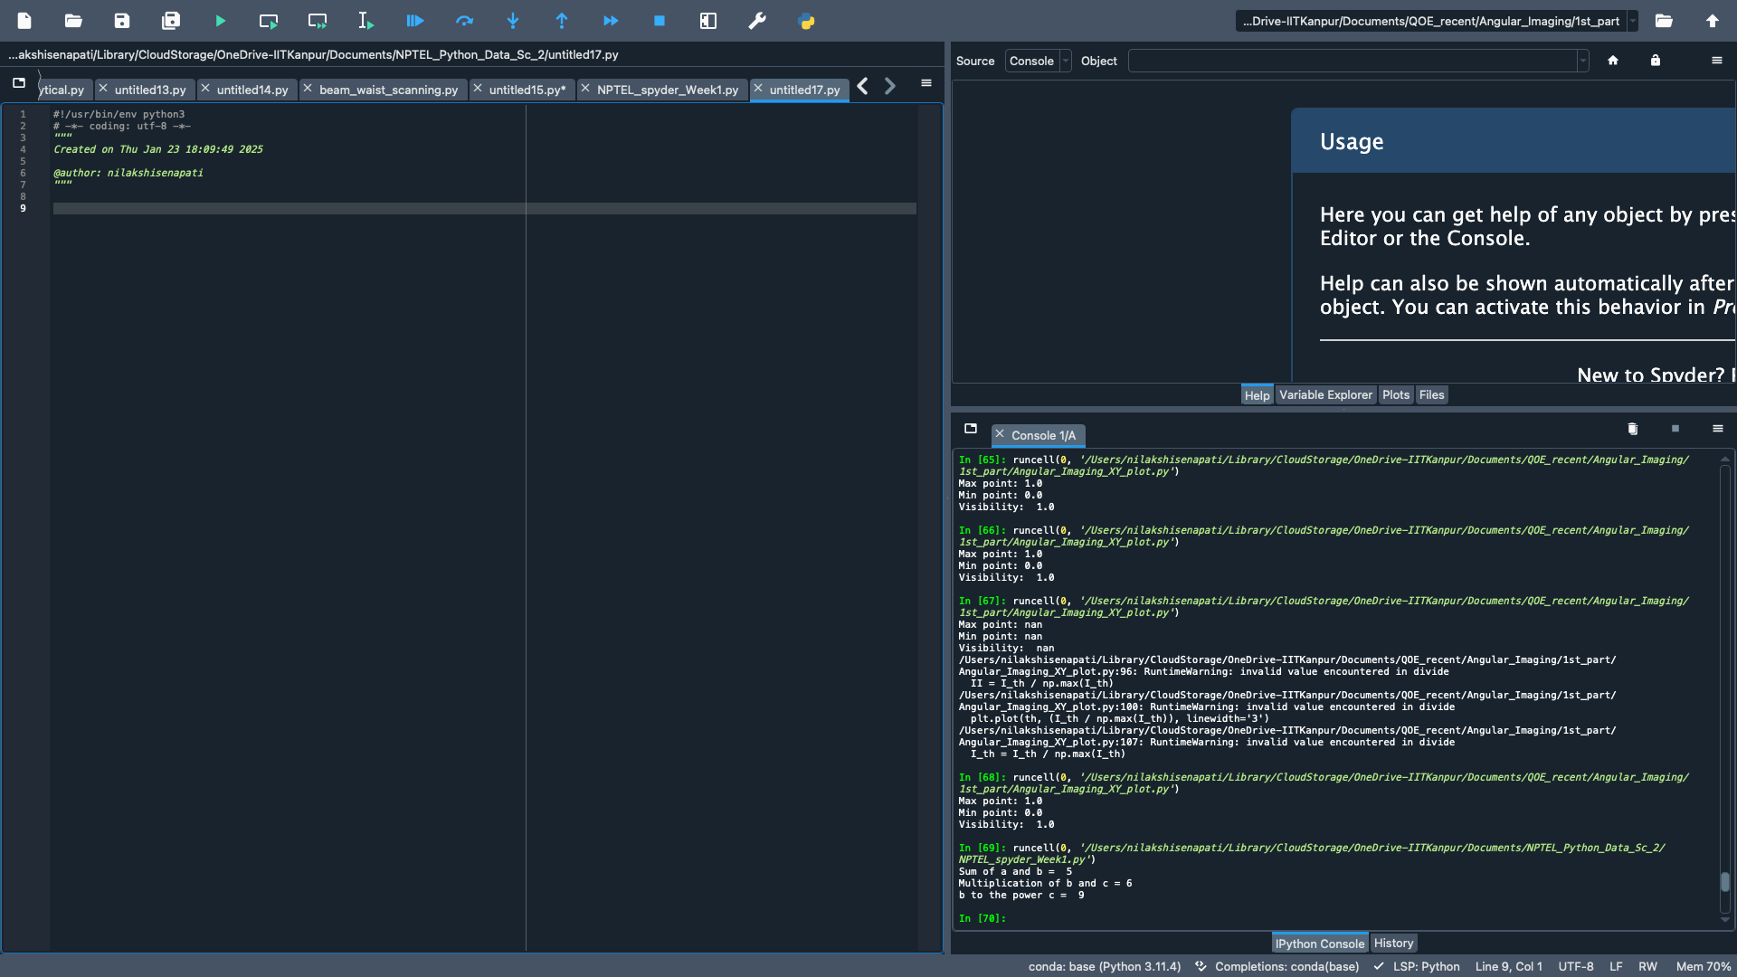
Week 1 : Set 1
Multipurpose window
Editor
Console

Slide 7
Python for Data Science
Tutorial 1 - 25.01.25
NPTEL
Week 1 : BASICS OF PYTHON SPYDER (TOOL)
Introduction Spyder
Setting working Directory
Creating and saving a script file
File execution, clearing console, removing variables from environment, clearing environment
Commenting script files
Variable creation
Arithmetic and logical operators
Data types and associated operations

Slide 8
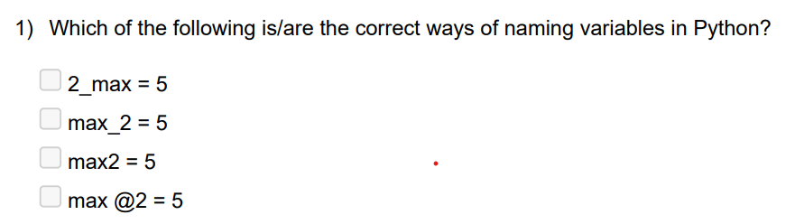
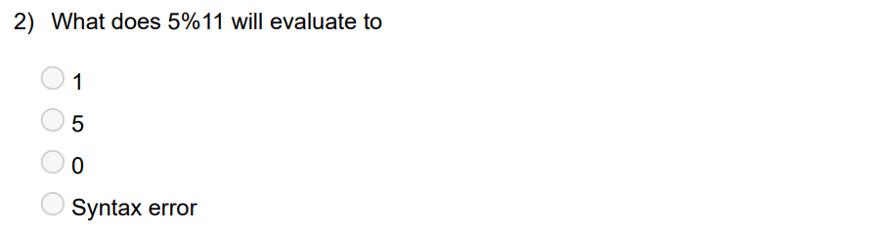
Week 1: Set 1

Slide 9
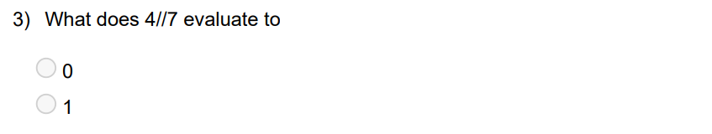
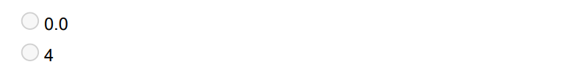
Week 1 : Set 1

Slide 10
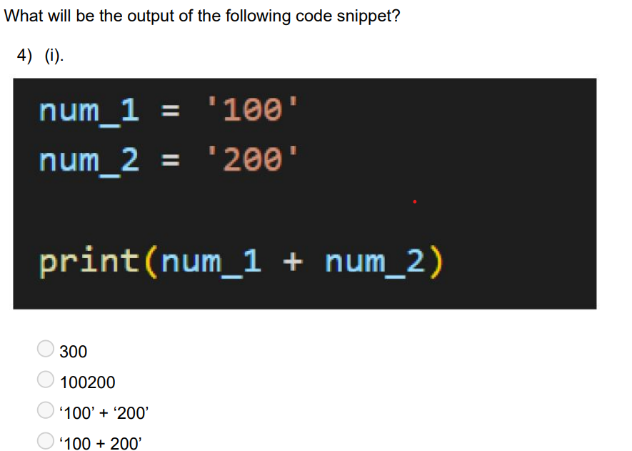
Week 1 : Set 1

Slide 11
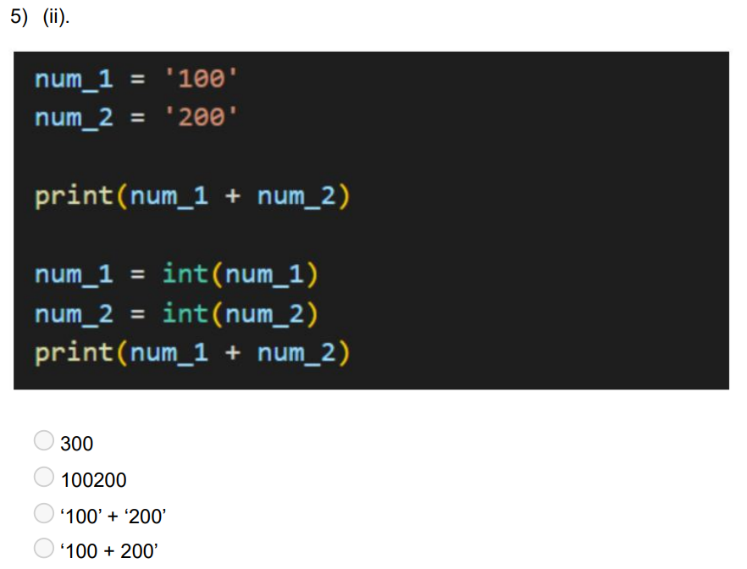
Week 1 : Set 1

Slide 12
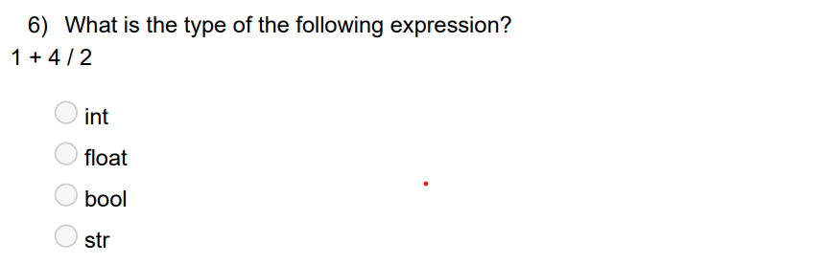
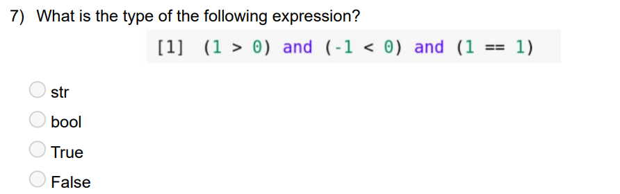
Week 1 : Set 1

Slide 13
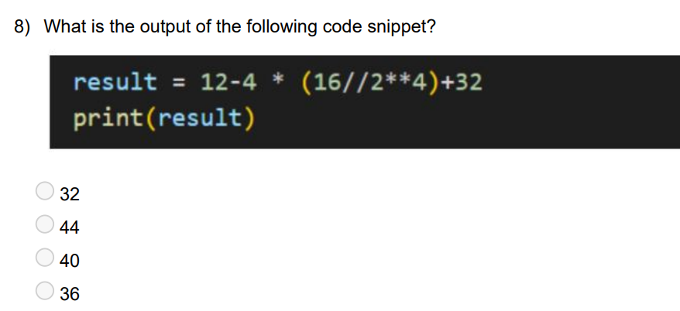
Week 1 : Set 1

Slide 14
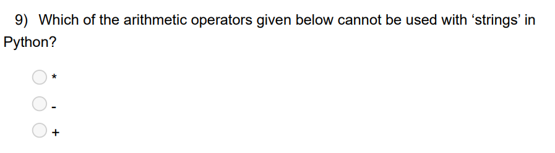
Week 1 : Set 1

Slide 15
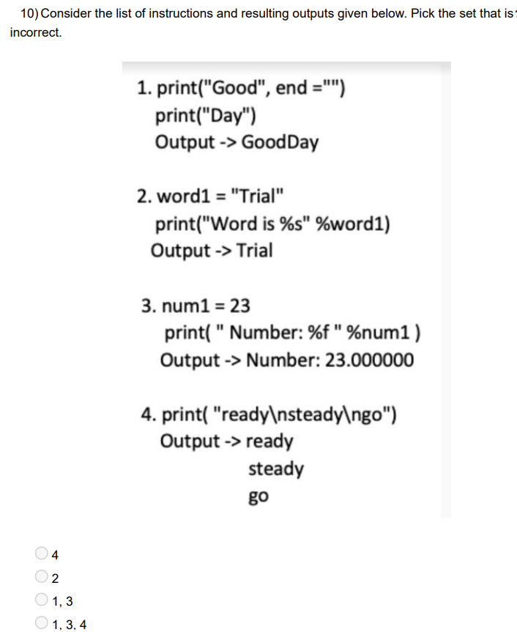
Week 1

Slide 16
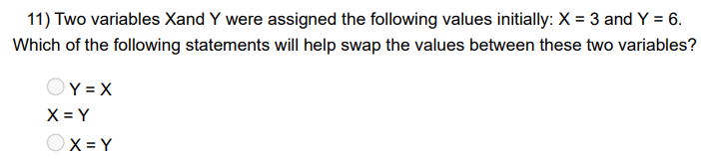
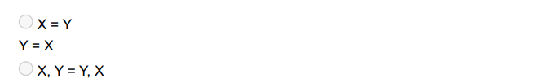
Week 1 : Set 1

Slide 17
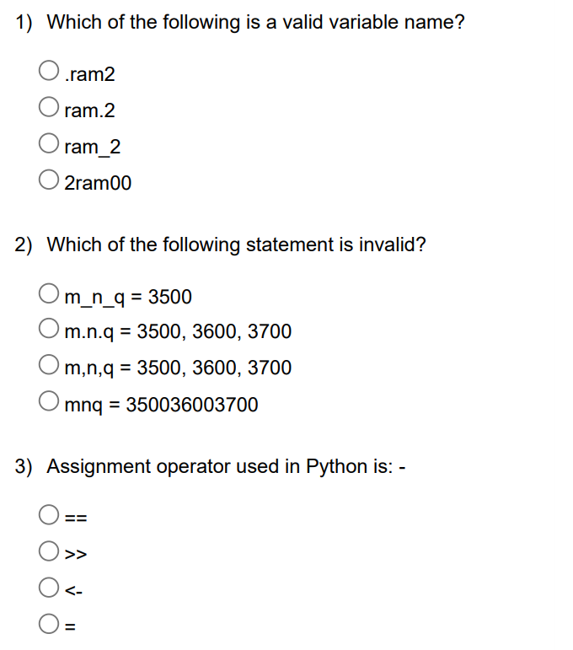
Week 1
Homework / Practice

Slide 18
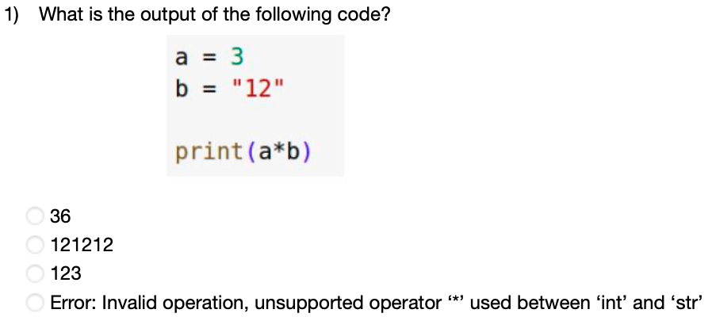
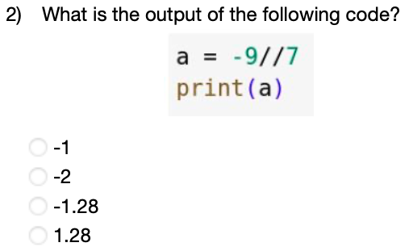
Week 1 : Set 2

Slide 19
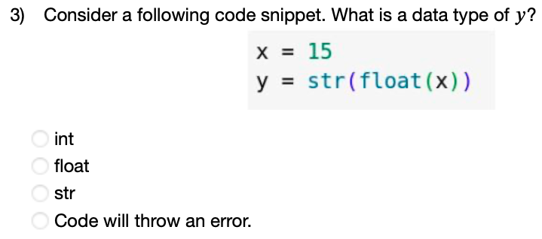
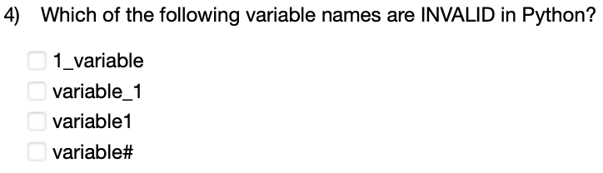
Week 1 : Set 2

Slide 20
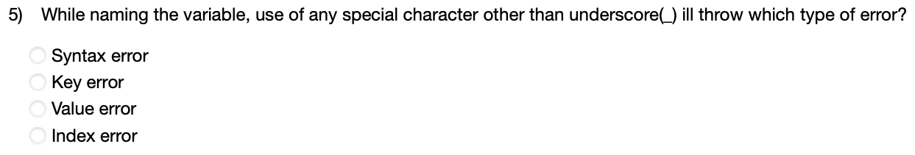
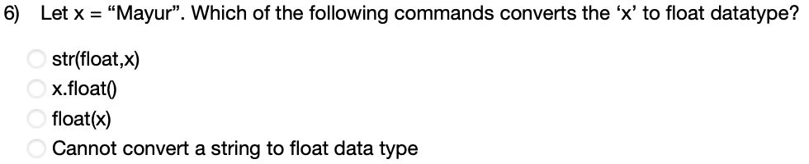
Week 1 : Set 2

Slide 21
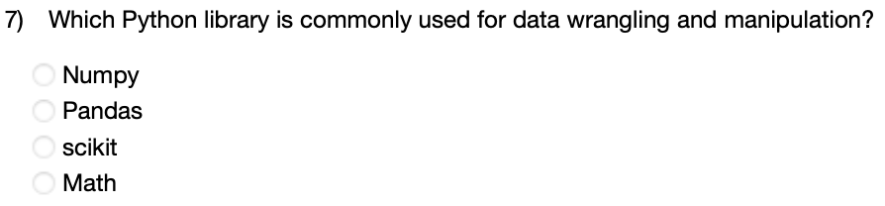
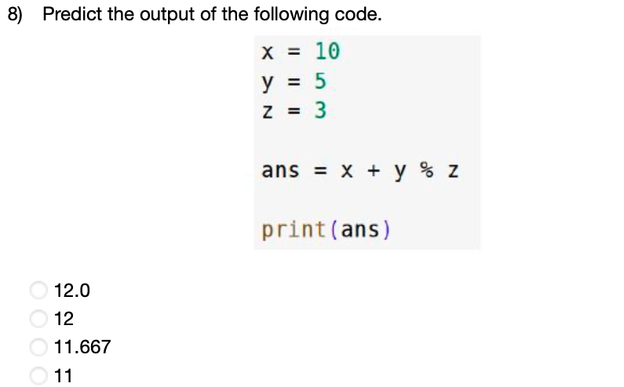
Week 1 : Set 2

Slide 22
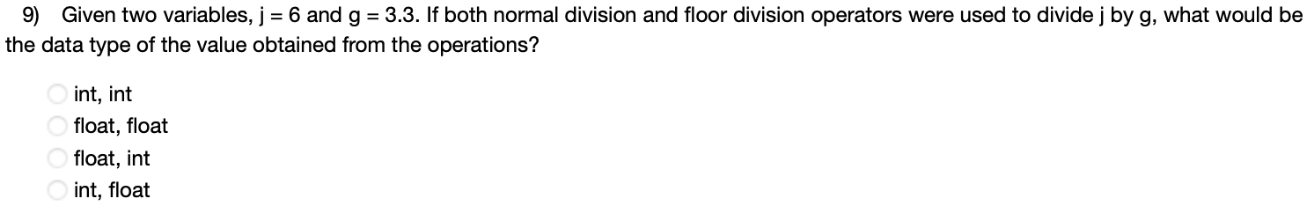
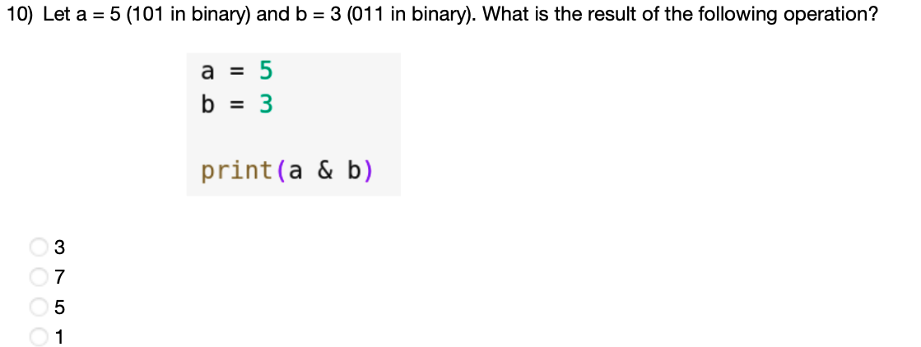
Week 1 : Set 2

Slide 23
Python for Data Science
Tutorial 2 - 01.02.24
NPTEL
Instructor: Prof. Ragunathan Rengasamy(IIT Madras)
TA : Nilakshi Senapati (IIT Kanpur)
Problem Solving and Doubt Clearing :
Every Saturday 5:00 pm to 7:00 pm

Slide 24
Python for Data Science
Tutorial 2 - 01.02.24
NPTEL
Week 2 : Sequence data types and associated operations
Strings
Lists
Arrays
Tuples
Dictionary
Sets
Range
ndArray

Slide 25
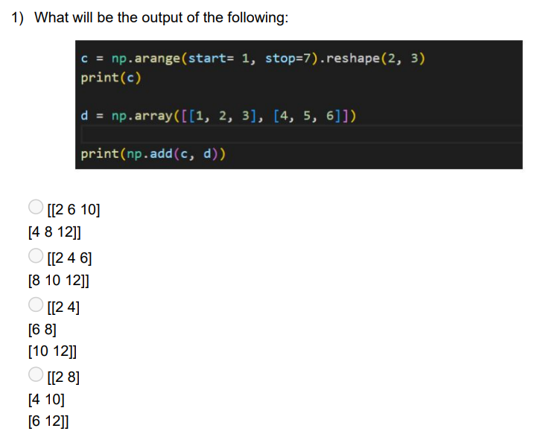
Week 2

Slide 26
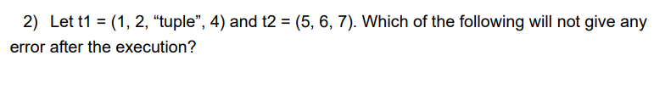
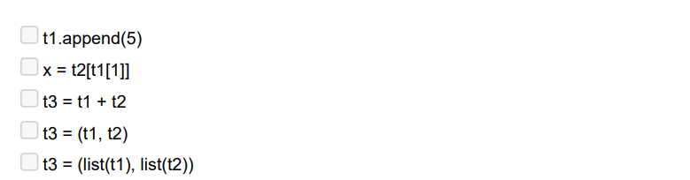
Week 2

Slide 27
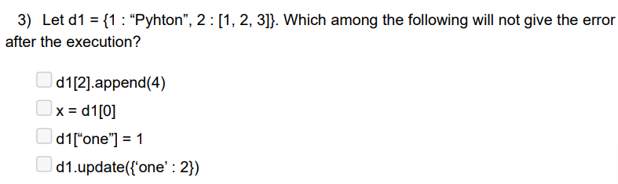
Week 2

Slide 28
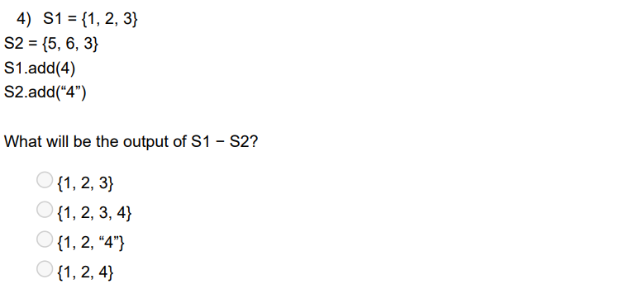
Week 2

Slide 29
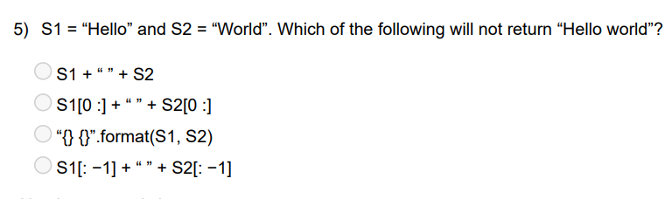
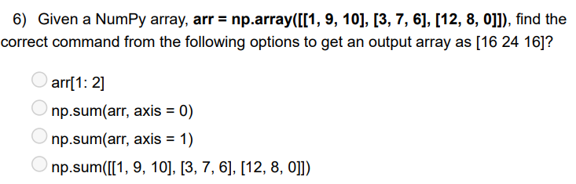
Week 2

Slide 30
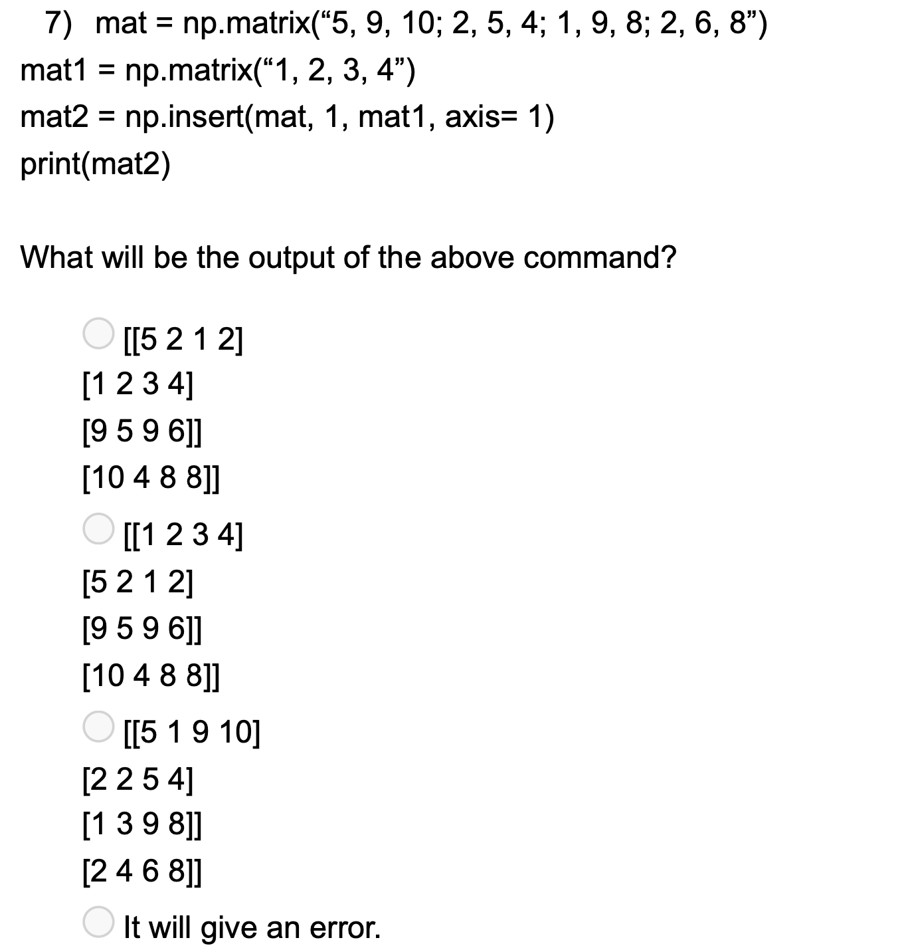
Week 2

Slide 31
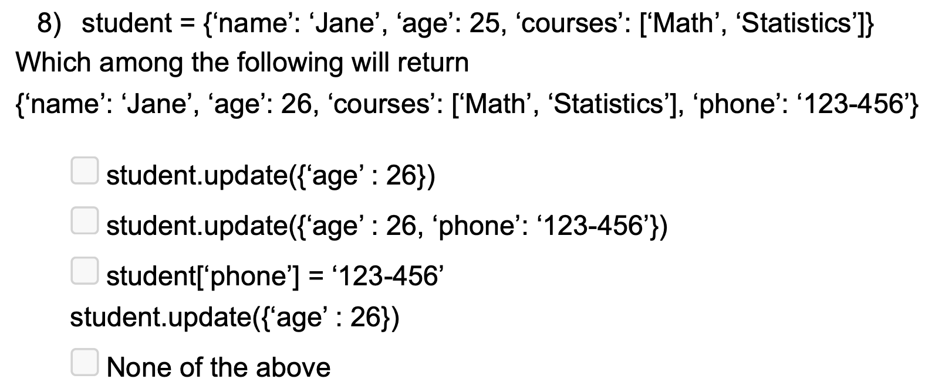
Week 2

Slide 32
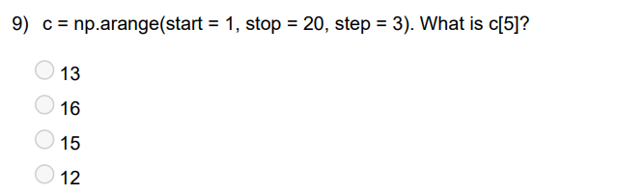
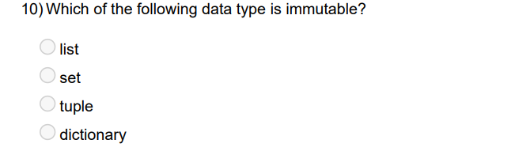
Week 2

Slide 33
Python for Data Science
Tutorial 3 - 08.02.25
NPTEL
Instructor: Prof. Ragunathan Rengasamy(IIT Madras)
TA : Nilakshi Senapati (IIT Kanpur)
Problem Solving and Doubt Clearing :
Every Saturday 5:00 pm to 7:00 pm

Slide 34
Python for Data Science
Tutorial 3 - 08.02.25
NPTEL
Week 3 : Many important topics
Reading files
Exploratory data analysis
Data preparation and preprocessing
Scatter plot
Line plot
Bar plot
Histogram
Box plot
Pair plot
if-else family
for loop
for loop with if break
while loop

Slide 35
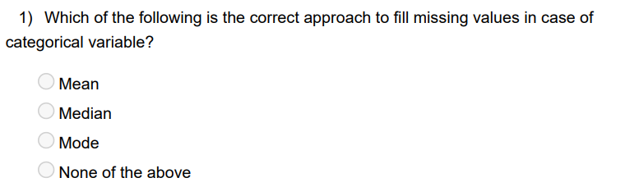
Week 3

Slide 36
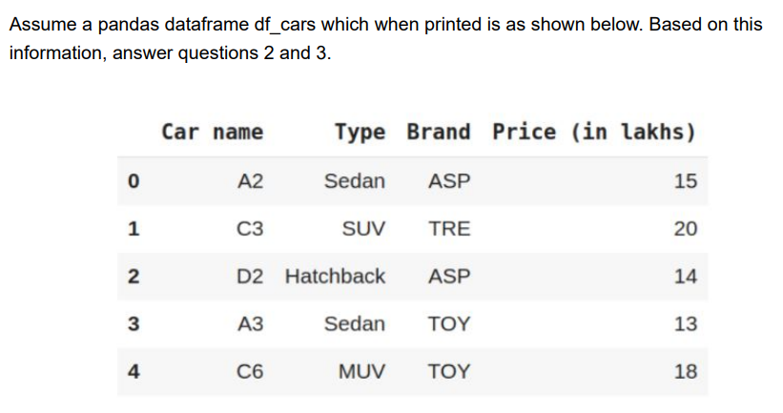
Week 3

Slide 37
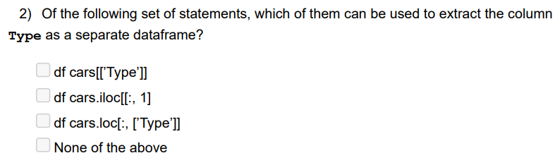
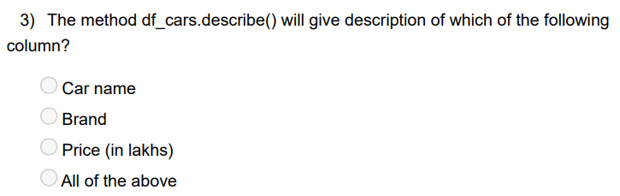
Week 3

Slide 38
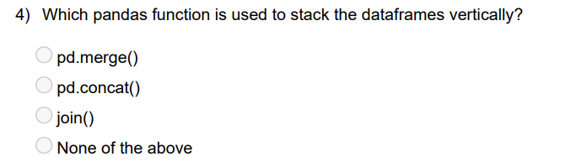
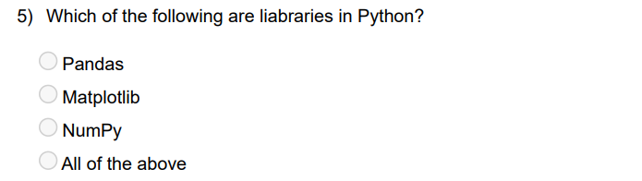
Week 3

Slide 39
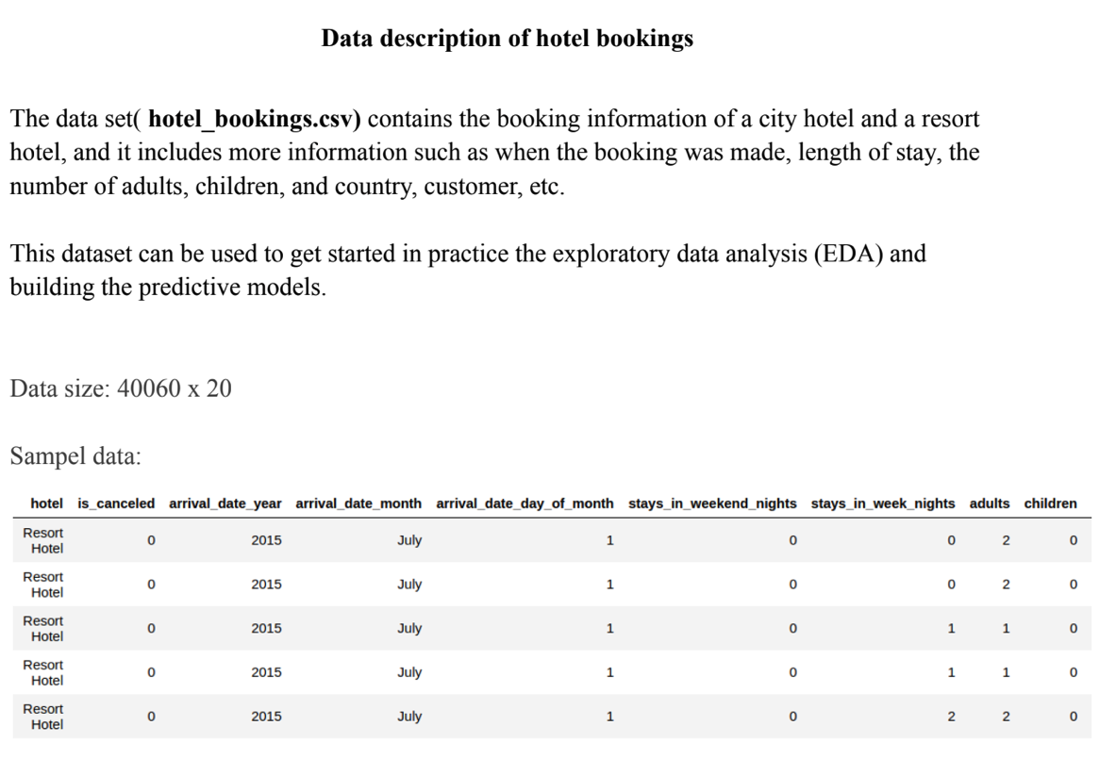
Week 3
hotel_bookings.csv

Slide 40
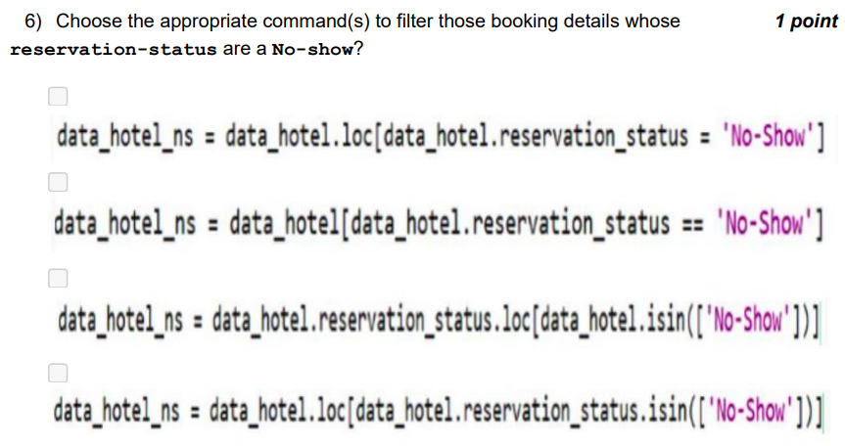
Week 3

Slide 41
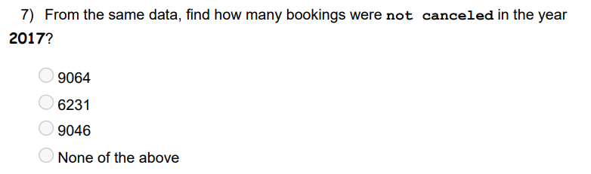
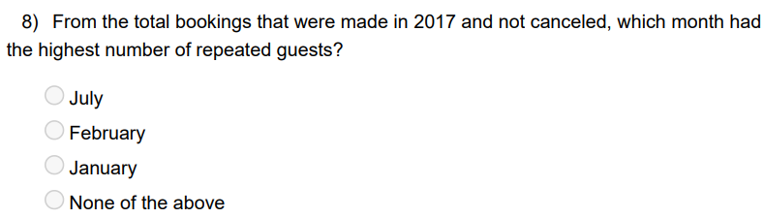
Week 3

Slide 42
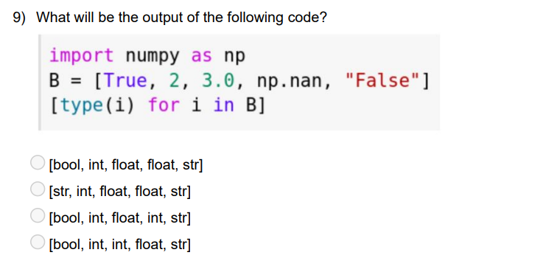
Week 3

Slide 43

Week 3

Slide 44
Python for Data Science
Tutorial 4 - 15.02.25
NPTEL
Instructor: Prof. Ragunathan Rengasamy(IIT Madras)
TA : Nilakshi Senapati (IIT Kanpur)
Problem Solving and Doubt Clearing :
Every Saturday 5:00 pm to 7:00 pm

Slide 45
Python for Data Science
Tutorial 4 - 15.02.25
NPTEL
Week 4 : Case Study
Regression
Predicting price of pre-owned cars
Classification
Classifying personal income

Slide 46

Week 4

Slide 47

Week 4

Slide 48

Week 4

Slide 49


Week 4

Slide 50

Week 4

Slide 51

Week 4

Slide 52

Week 4

Slide 53

Week 4

Slide 54

Week 4

Slide 55

Week 4

Slide 56

Week 4

